Slide 1



2
0
20
Project on data analysis
Inter Stock
Price
SUPPORTED BY BOARD INFINITY
This presentation is created to show the data analysis done by me on Tesla Inter Stock Price to get the data of Actual stocks of company.
Refer Analysis

Slide 2
3
DashBoarding
2
LEARNING
1
ANALYTICS

Slide 3
STEP
STEP
STEP
1
3
5
Daily Closing Price
Daily high and low
Presenting analysis on Dashboard
Collecting a data set.
Volume Trade on Daily Basis
% Change Between open and Close
STEP
STEP
STEP
2
4
6

Slide 4
Source of data
The data set used in this project is collected from google sheet with the help of its inbuilt function.
GOOGLEFINANCE
Syntax :-
GOOGLEFINANCE(ticker, [attribute], [start_date], [end_date|num_days],
[interval])
where,
Ticker - This is the series of letters that represent a company being traded on an exchange.(For Tesla it was TSLA)
Return

Slide 5
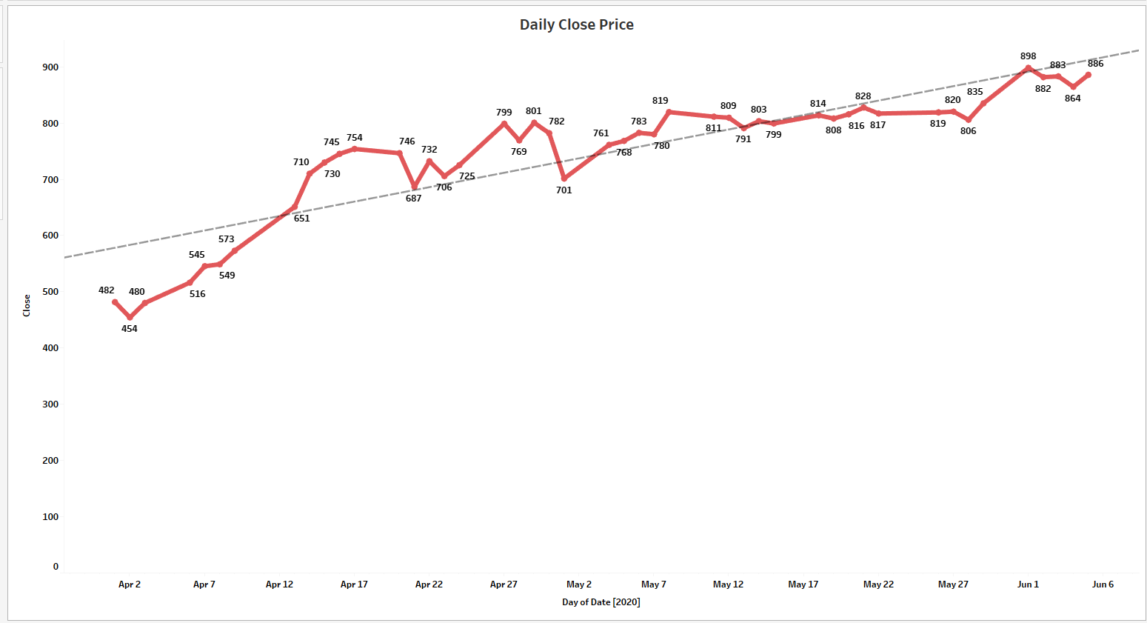
Daily closing price
The below graph shows the closing price on daily basis for intra stock price and a Trend Line will indicates how the price got increased on daily basis.
Return

Slide 6
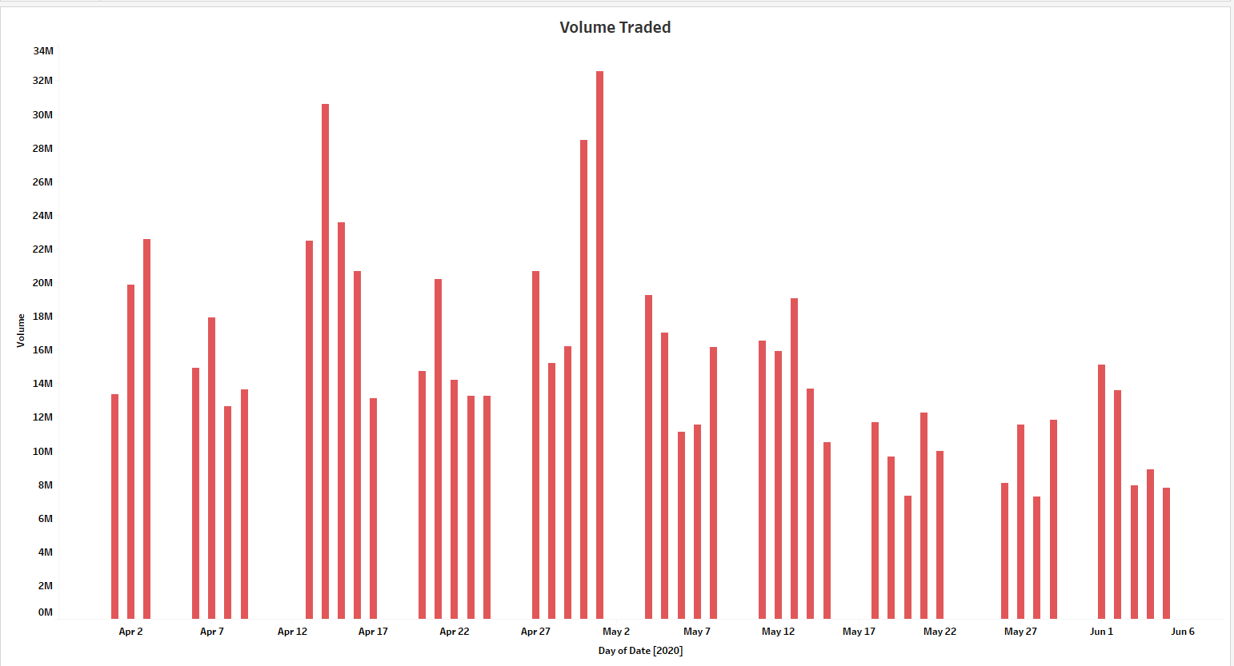
Volume Trade on Daily Basis
The below representation on the graph shows the volume trade on daily basis.
1 May 2020
20 May 2020
Lowest Trade
Highest Trade
7.5M
32M
Return

Slide 7
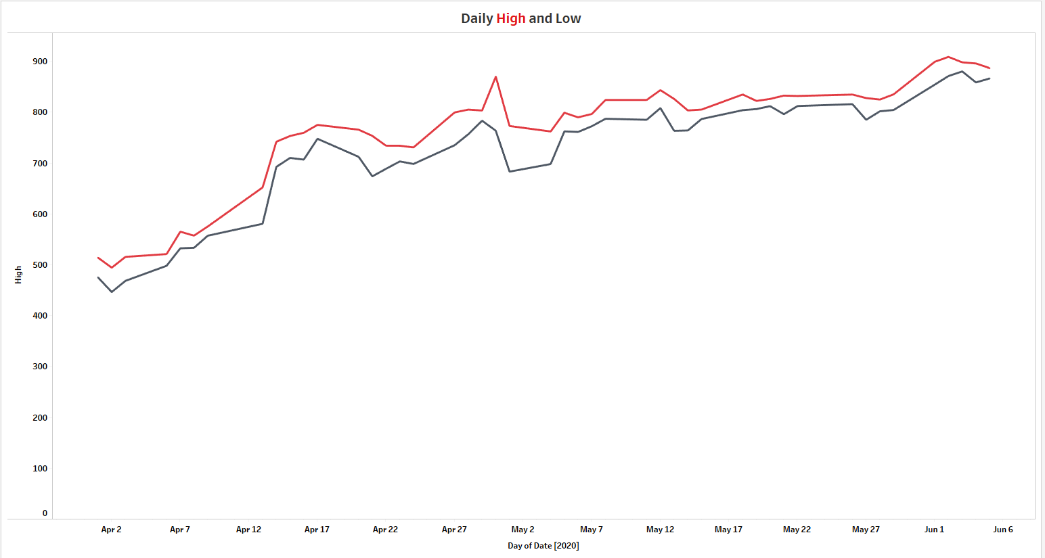
Daily High and Low
The below representation on the graph shows the Highest and Lowest Daily Price
Return

Slide 8
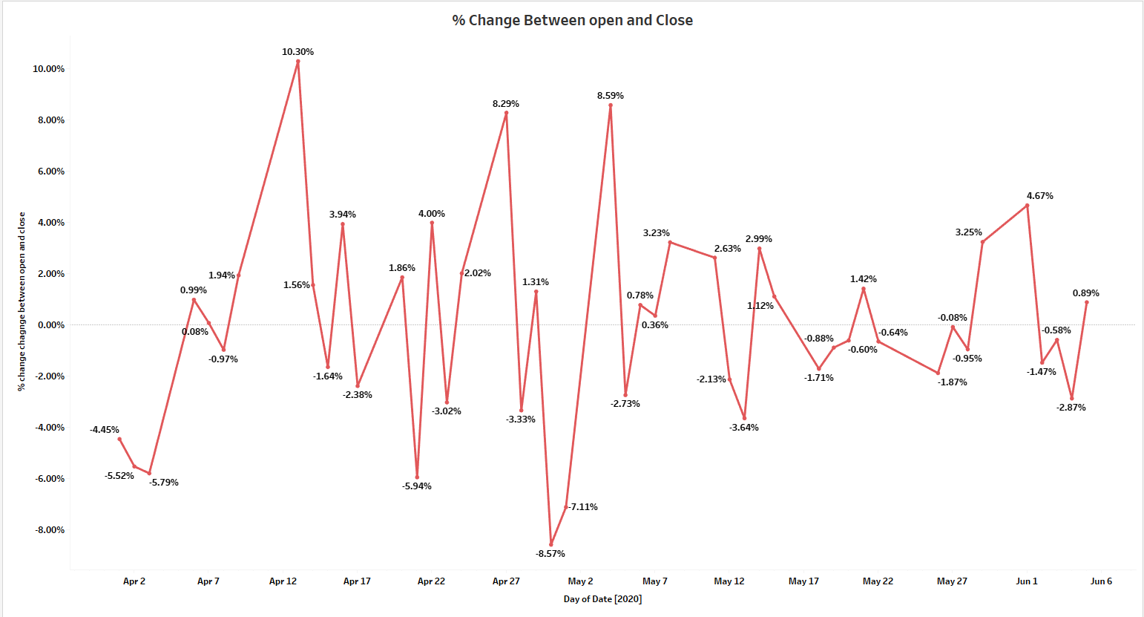
% Change Between open and Close
The below data and its representation on the graph shows the difference between opening and closing price
BUY
SELL
Return

Slide 9
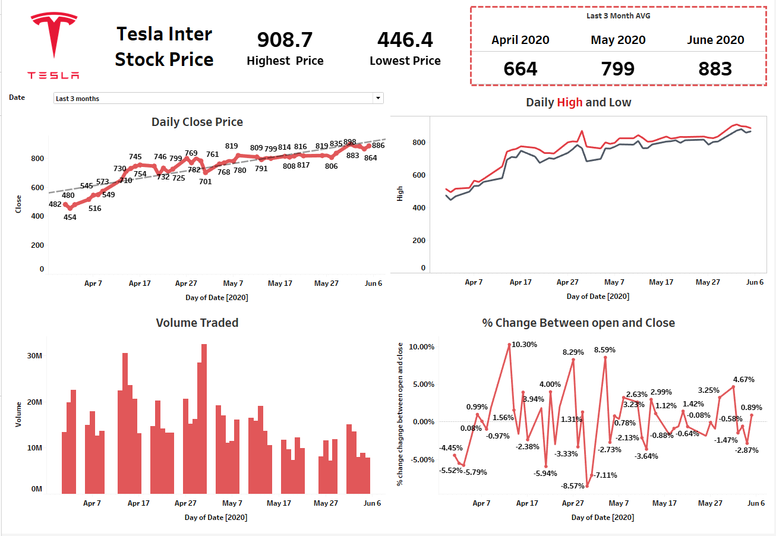

Slide 10
Thank You
Video link…..
Introduction link :- https://drive.google.com/file/d/1lfLWe5eXsd8nAKr-bTdjxtKsSPqIHuRY/view?usp=sharing
Made By – A. Yash Kumar Rao

